Slide 1

SWIGGY DATA ANALYSIS
By: Saurabh Kumar Kushwaha

Slide 2
INTRODUCTION
The online food ordering market includes foods prepared by restaurants, prepared by independent people, and groceries being ordered online and then picked up or delivered. The first online food ordering service, World Wide Waiter (now known as Waiter.com), was founded in 1995. Online food ordering is the process of ordering food from a website or other application. The product can be either ready-to-eat food or food that has not been specially prepared for direction consumption.

Slide 3
OBJECTIVE
Objective:
In the world of rising new technology and innovation, Food industry is advancing with the role of Data Science and Analytics. Data analysis can help them to understand their business in a quiet different manner and helps to improve the quality of the service by identifying the weak areas of the business.
Benefits:
Help out to make better business decisions.
Help analyze customer trends and satisfaction, which can lead to new and better
products and
services.
Helps in easy flow for managing resources.

Slide 4
PROBLEM STATEMENT
Food industries are having important reflection of the economy from past few decades. Online
food ordering is the process of ordering food from a website or other application.
In this project, we are analyzing the various aspects with different use cases which covers many aspects of Swiggy Food Delivery Service. It helps in not only understanding the meaningful relationships between attributes, but it also allows us to do our own research and come-up with our findings.

Slide 5
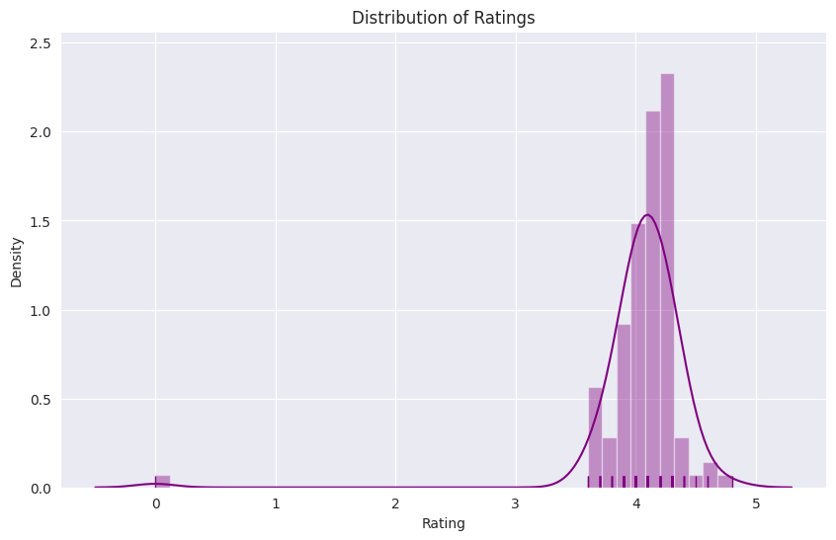
1.DISTRIBUTION OF 'RATING':
Conclusion:
Based on the Distribution Plot, it can be inferred that over 50% of the restaurants have a rating higher than 4.1, and the maximum rating observed is 4.8, which is considered a respectable rating.
This data suggests that the majority of these restaurants are performing admirably and have ratings that align with customer satisfaction.

Slide 6
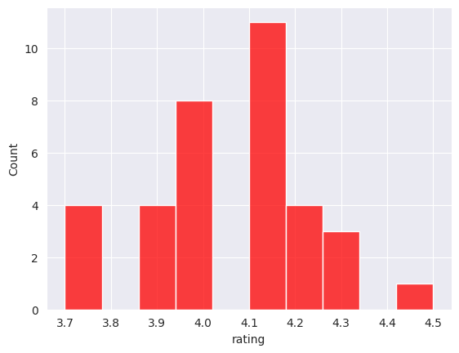
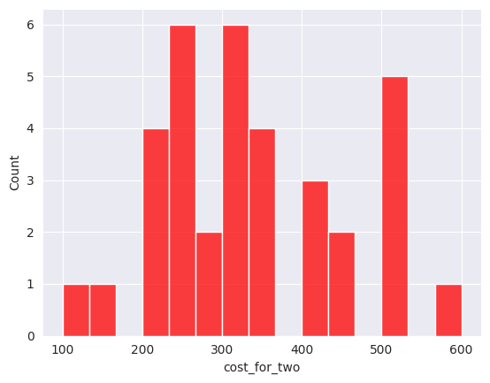
AREA WISE COST AND RATING
BTM Area:
Conclusion:
The majority of restaurants have ratings ranging from 4.0 to 4.2, approximately.
The cost for two individuals at the restaurants typically falls within the range of 200 to 350, with the maximum cost occasionally reaching up to 600.

Slide 7
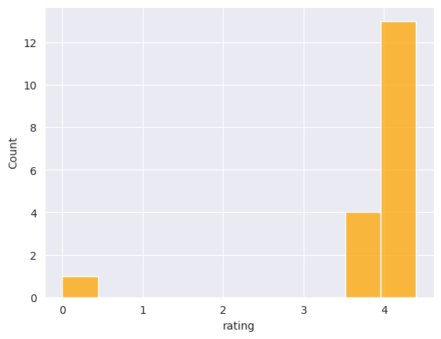
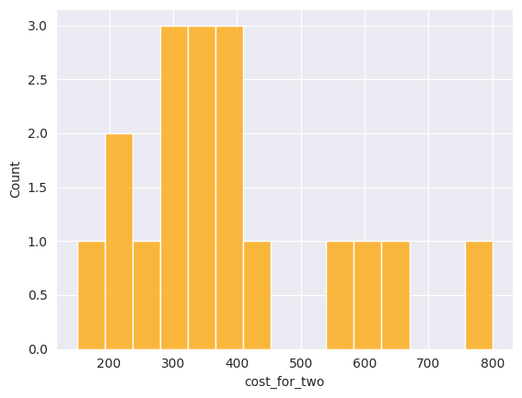
2. AREA-WISE ANALYSIS ON ‘RATING’ AND ‘COST_FOR_TWO (₹)’ :
HSR Area:
Conclusion:
The majority of restaurants in the dataset have a rating of 4.0 or higher, approximately.
The cost for two people typically ranges from 300 to 400, with some restaurants having a maximum cost of 800.

Slide 8
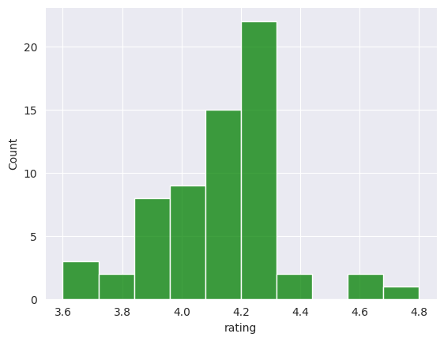
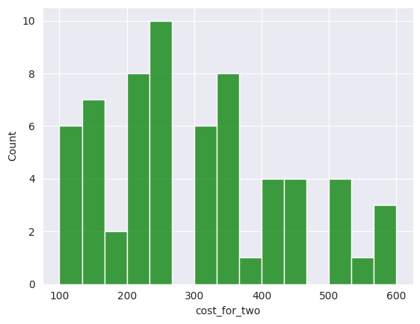
2. AREA-WISE ANALYSIS ON ‘RATING’ AND ‘COST_FOR_TWO (₹)’ :
Koramangala Area:
Conclusion:
The majority of restaurants have ratings ranging from 4.0 to 4.3, approximately.
The cost for two people ranges from 200 to 350, with the maximum cost going up to 600.
.

Slide 9
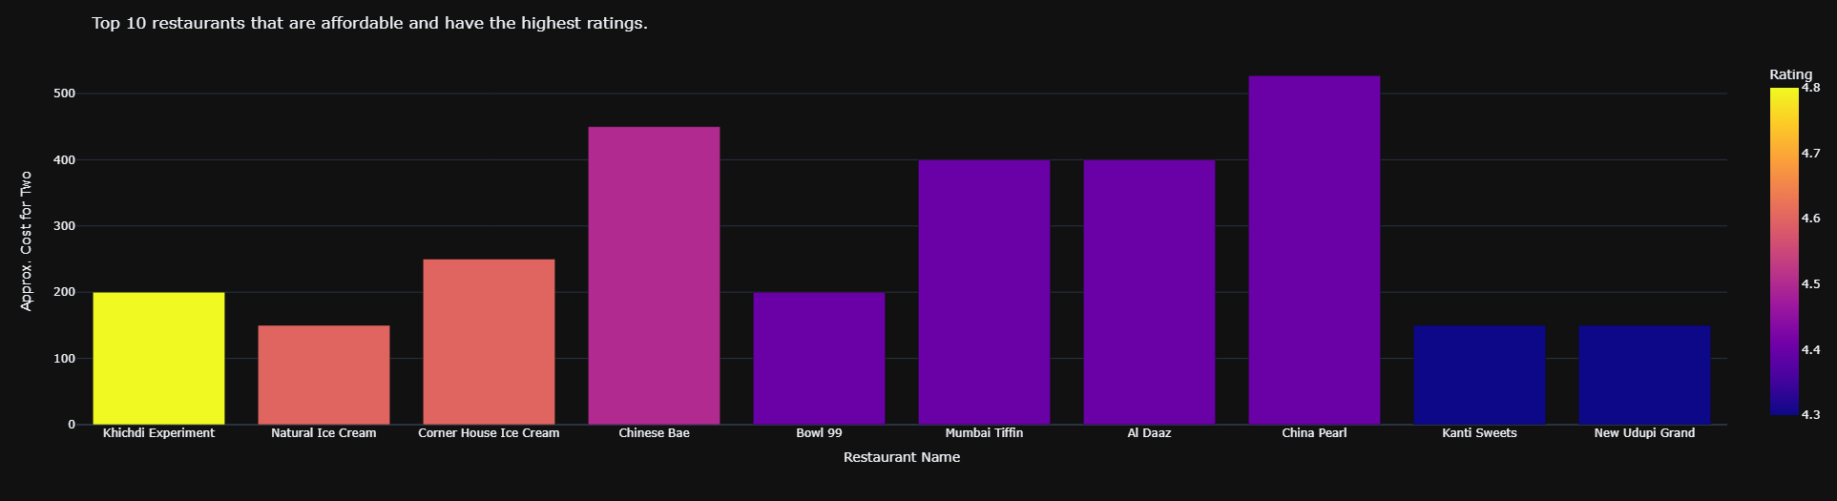
4. ANALYZE AFFORDABLE/BUDGETED AND HIGHEST RATED RESTAURANTS OF BANGALORE:
Conclusion:
This beautiful "Bar Chart" displays all the Affordable/Budgeted and Highest Rated Restaurants available in the entire Bangalore Area.

Slide 10
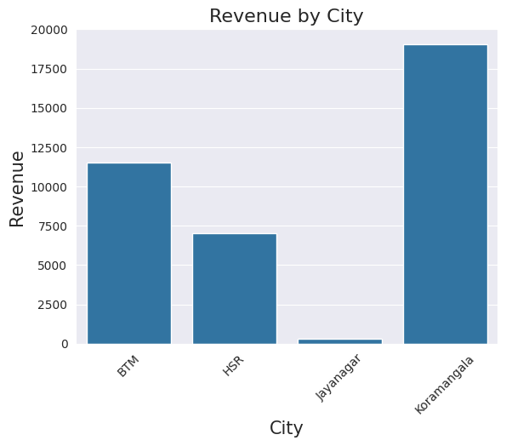
5. REVENUE IN EACH AREA
Conclusion:
This beautiful "Bar Chart" displays all the Cheapest and Highest Rated Restaurants available in the entire Bangalore Area with Approx. Cost for Two People.

Slide 11
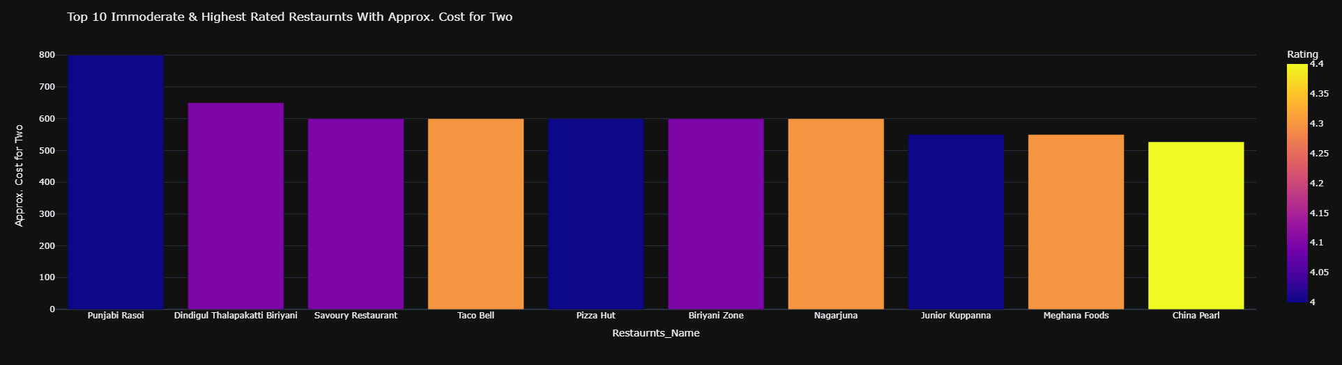
6. TOP 10 EXPENSIVE & HIGHEST RATED RESTAURANTS WITH APPROX. COST FOR 2 PEOPLE:
Conclusion:
This beautiful "Bar Chart" displays all the Expensive and Highest Rated Restaurants available in the entire Bangalore Area with Approx. Cost for Two People.

Slide 12
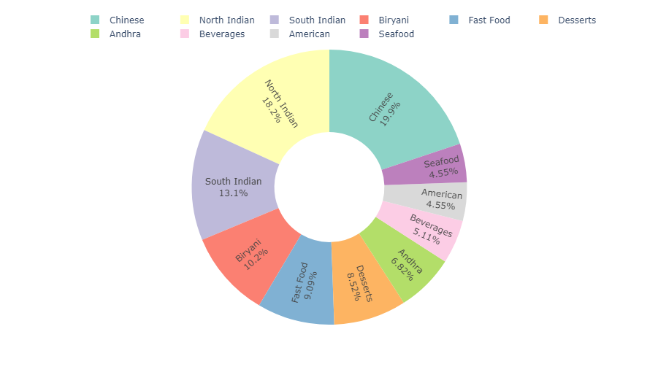
CUISINE ANALYSIS
7. Top 6 Cuisines in the Bangalore City
Conclusion : From the Pie Chart Visualization, we observe that the majority of restaurants in Bangalore serve:
Chinese cuisine, accounting for approximately 19.9%.
North Indian cuisine, representing around 18.2%.
South Indian cuisine, comprising about 13.1%.
These findings indicate the popularity and diversity of these cuisines within the Bangalore restaurant scene. Entrepreneurs and food enthusiasts can leverage this information to understand the preferences of residents and explore the wide range of Chinese, North Indian, and South Indian restaurants available in the city.

Slide 13
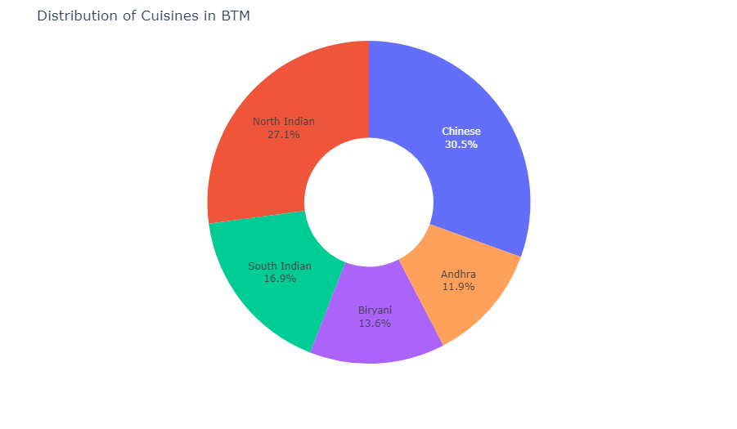
CUISINE ANALYSIS
10. Distribution of Cuisines in BTM Bangalore
Restaurants:
Conclusion : "BTM's culinary scene offers a diverse range of flavors. Chinese cuisine dominates with 30%, followed by North Indian at 27.1%. South Indian holds 16.9%, while Biryani and American cuisines claim 13.6% and 11.9% respectively. From spicy Chinese dishes to aromatic North Indian curries, BTM satisfies cravings for a variety of global flavors."
This condensed version provides a brief overview of the pie chart insights, emphasizing the dominant cuisines in BTM while highlighting the diversity of flavors available in the neighborhood.

Slide 14
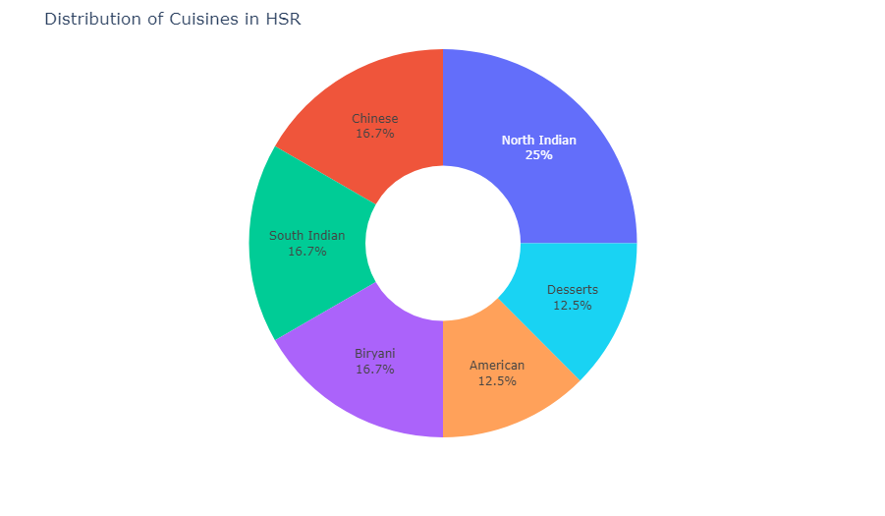
CUISINE ANALYSIS
12. Distribution of Cuisines in HSR Bangalore
Restaurants:
Conclusion : "HSR boasts a diverse culinary scene with North Indian cuisine leading the way, representing 25% of the offerings. Chinese, South Indian, and Biriyani cuisines each hold a share of 16.7%, showcasing the area's appreciation for a variety of flavors. American and Desserts cuisines contribute 12.5% each, reflecting a global influence and a sweet tooth among HSR residents. With such diverse options, HSR promises a vibrant culinary experience for all palates."

Slide 15
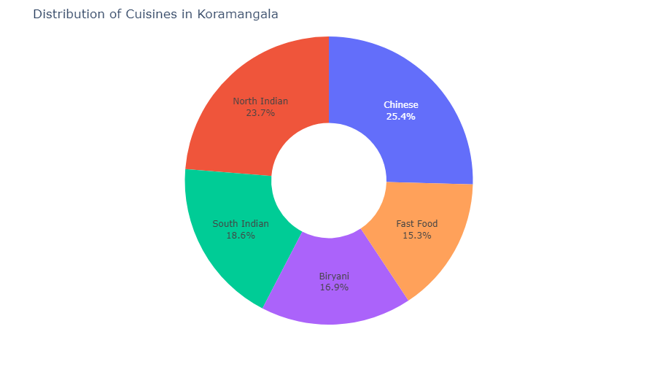
CUISINE ANALYSIS
. Distribution of Cuisines in Koramangala
Bangalore Restaurants:
Conclusion: Based on the pie chart visualization of the distribution of cuisines in the Koramangala area, the following insights can be derived:
Chinese cuisine has the highest representation, accounting for approximately 25.4% of the total cuisines in Koramangala.
North Indian cuisine follows closely behind with a share of around 23.7%.
South Indian cuisine is the third most popular, comprising approximately 18.6% of the cuisines.
Biriyani holds a significant portion with around 16.5% representation.
Fast food cuisine rounds up the top five with a share of about 15.3%.
These insights provide an overview of the culinary preferences in the Koramangala area, with Chinese and North Indian cuisines being particularly prominent choices. These findings can be valuable for understanding the local food scene and informing decisions related to restaurant offerings or culinary experiences in the area.

Slide 16
THANK YOU

